Slide 1
ALJABAR LINIER
Dr. RETNO KUSUMANINGRUM, S.SI., M.Kom.
Matriks
Matrix (Plural : Matrices)

Slide 2
Matrix (plural: matrices)
Matrix
a rectangular array of elements written within brackets
Represented with a capital letter and classify by its dimension
Dimensions of a Matrix/Order of a Matrix
determine by the number of horizontal rows and the number of vertical columns
Matrix Element
each number in a matrix
Notes:
Definisi matriks adalah susunan elemen yang disusun menurut baris dan kolom sehingga berbentuk persegi

Slide 3
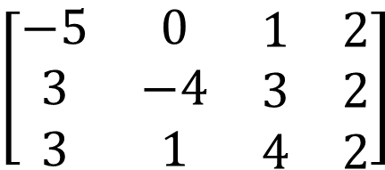
Writing the dimensions of a matrix.
4 columns
$$\left[\begin{matrix}−5 & 0 & \begin{matrix}1 & 2\end{matrix} \\ 3 & −4 & \begin{matrix}3 & 2\end{matrix} \\ 3 & 1 & \begin{matrix}4 & 2\end{matrix}\end{matrix}\right]$$
A=
3 rows
Matrix A is a 3 x 4 matrix.

Slide 4




Write the dimensions or order of each matrix.
6 5
-3 -7
1 0 9
$$3×3$$
-4 1/3 -3
$$1×3$$
10 0
1 -5
-6.2 9
5 0
-2 0.5 17
$$2×3$$
$$3×2$$

Slide 5
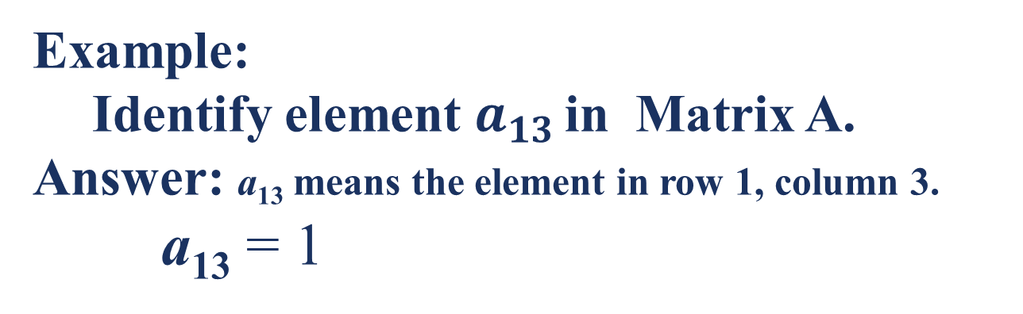
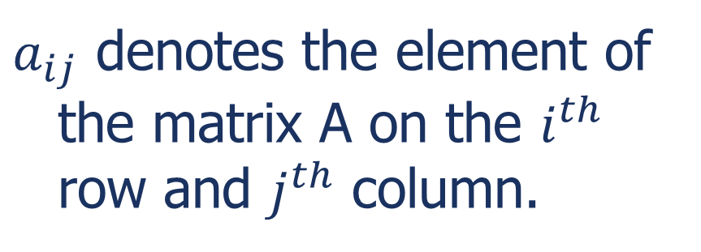
Identifying a Matrix Element
$a_{ij}$ denotes the element of the matrix A on the $i^{th}$ row and $j^{th}$ column.
Example:
Identify element $a_{13}$ in Matrix A.
Answer: a₁₃ means the element in row 1, column 3.
a₁₃ = 1

Slide 6
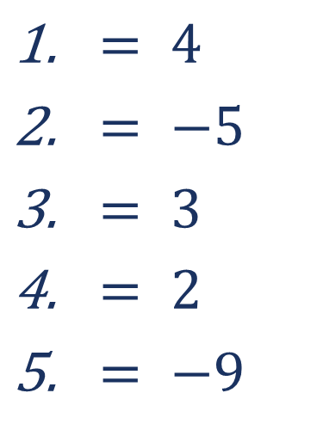
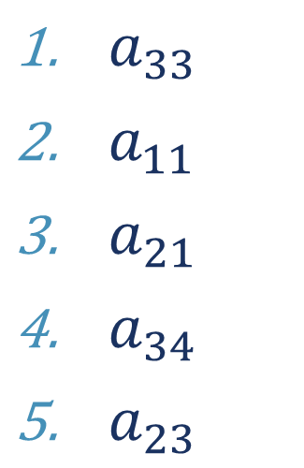
Identify each matrix element
A=
$a_{33}$
$a_{11}$
$a_{21}$
$a_{34}$
$a_{23}$
$= 4$
$= −5$
$= 3$
$= 2$
$= −9$

Slide 7
Adding and Subtracting Matrices
to add or subtract matrices A and B with the same dimensions, add or subtract the corresponding elements
***Note: you can only add or subtract matrices with the same dimensions.

Slide 8
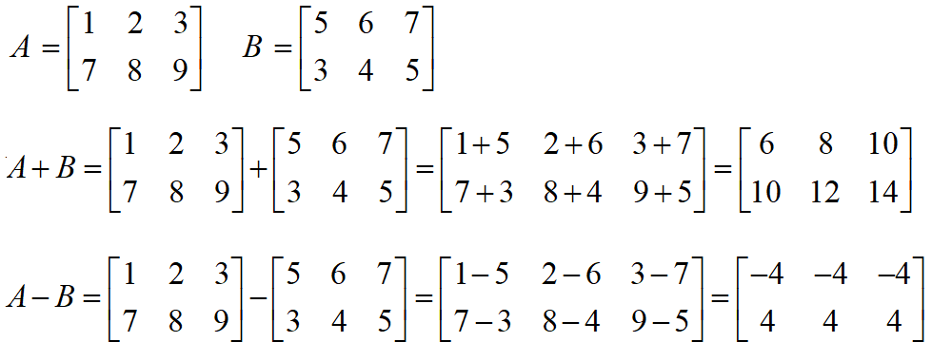
EXAMPLE : Matrix Addition AND SUBSTRACTION

Slide 9
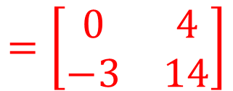
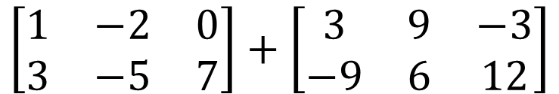
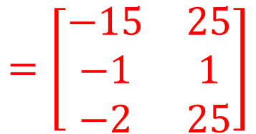
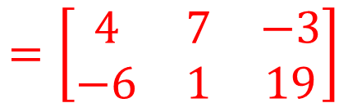
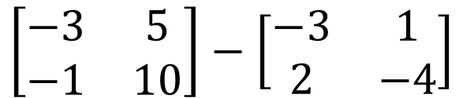
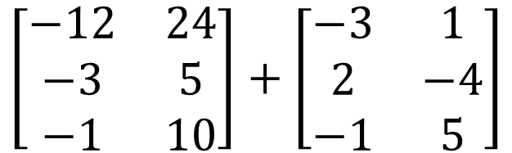
Find the sum or difference of each matrix.
1.
$$\left[\begin{matrix}1 & −2 & 0 \\ 3 & −5 & 7\end{matrix}\right]+\left[\begin{matrix}3 & 9 & −3 \\ −9 & 6 & 12\end{matrix}\right]$$
$$=\left[\begin{matrix}4 & 7 & −3 \\ −6 & 1 & 19\end{matrix}\right]$$
2.
$$\left[\begin{matrix}−12 & 24 \\ −3 & 5 \\ −1 & 10\end{matrix}\right]+\left[\begin{matrix}−3 & 1 \\ 2 & −4 \\ −1 & 5\end{matrix}\right]$$
$$=\left[\begin{matrix}−15 & 25 \\ −1 & 1 \\ −2 & 25\end{matrix}\right]$$
=
3.
$$\left[\begin{matrix}−3 & 5 \\ −1 & 10\end{matrix}\right]−\left[\begin{matrix}−3 & 1 \\ 2 & −4\end{matrix}\right]$$
$$=\left[\begin{matrix}0 & 4 \\ −3 & 14\end{matrix}\right]$$

Slide 10
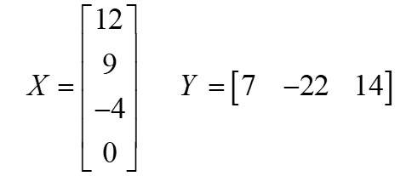
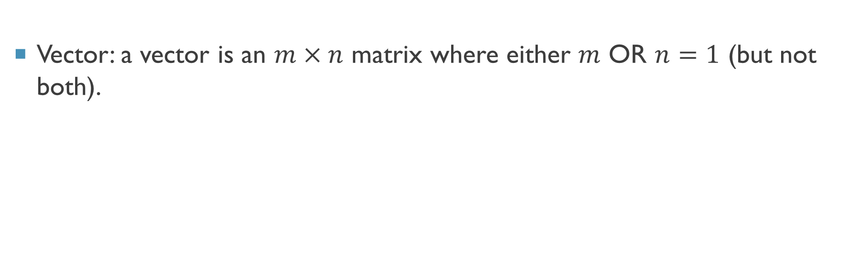
“Special” Matrices
Vector: a vector is an $m×n$ matrix where either $m$ OR $n=1$ (but not both).

Slide 11
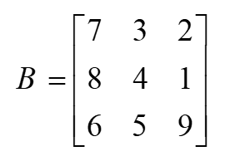
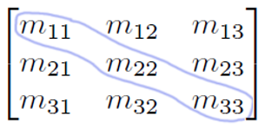
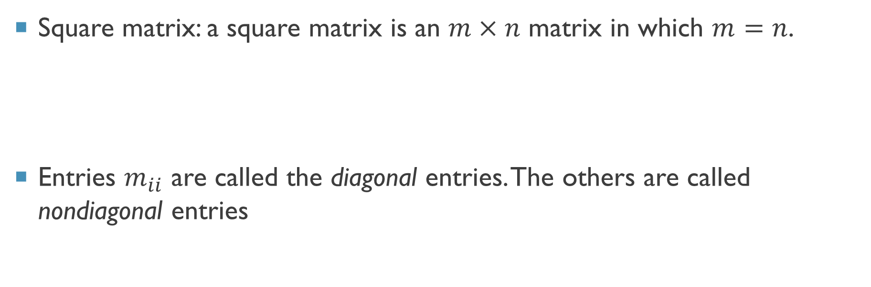
“Special” Matrices
Square matrix: a square matrix is an $m×n$ matrix in which $m=n$.
Entries $m_{ii}$ are called the diagonal entries. The others are called nondiagonal entries

Slide 12

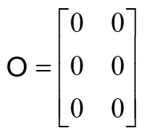

“Special” Matrices
Scalar: a scalar is an $m×n$ matrix where BOTH $m$ AND $n=1$ .
Zero matrix: an $m×n$ matrix of zeros.

Slide 13
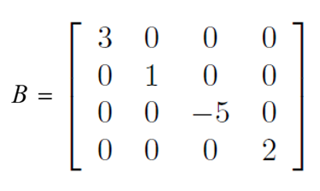
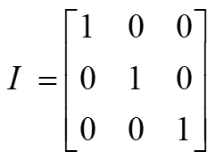

“Special” Matrices
Diagonal Matrix: a square matrix whose nondiagonal elements are zero.
Identity Matrix: a square ($m×m$) matrix with $1$s on the diagonal and zeros everywhere else.

Slide 14
Properties: Matrix Addition
If A, B, and C are m x n matrices, then Closure Property A + B is an m x n matrix
Commutative Property
A + B = B + A
Associative Property for Addition
(A + B) + C = A + (B + C)
“Additive Identity” Property ➔ There exist a unique m x n matrix O such that
O + A = A + O = A
“Additive Inverse” Property ➔ For each A, there exists a unique opposite –A.
A + (-A) = O

Slide 15
Identify whether the two matrices are additive inverse or not.
1.
5
0 -2
,
-14 -5
0 2
Yes.
Find the “additive inverse” of the given matrix.
1.
-1 10 -5
0 2 -3
=>
-10 5
0 -2 3

Slide 16
Solving Matrix Equations
Matrix Equation
an equation in which the variable is a matrix
Equal Matrices
matrices with the same dimensions and with equal corresponding elements

Slide 17
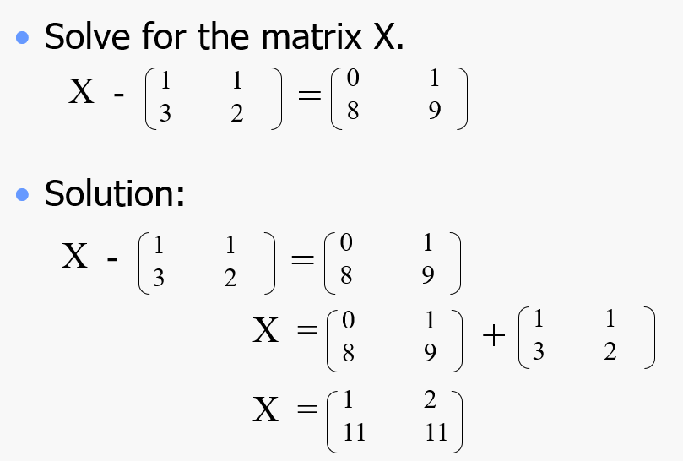
SOLVING A MATRIX EQUATION

Slide 18
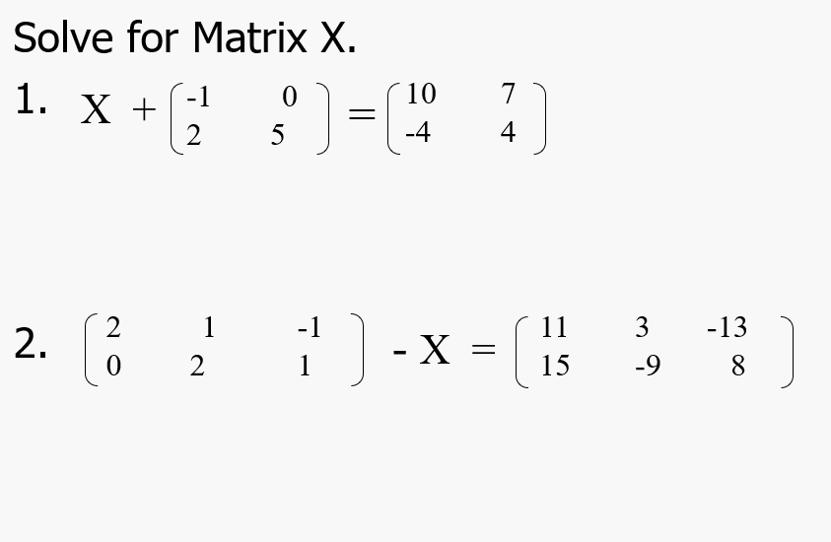
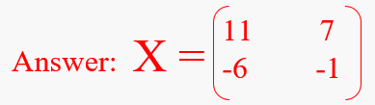
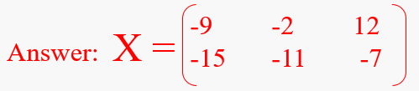
EXERCISE

Slide 19
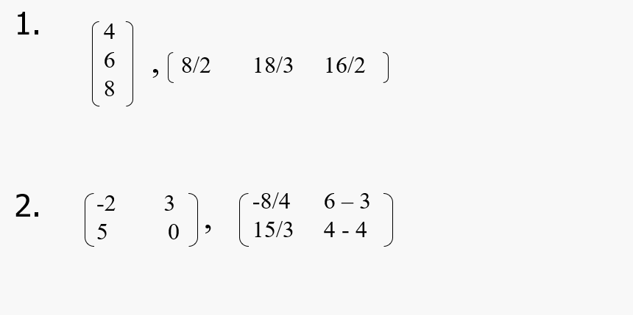

EXERCISE (CONT’D)
Determine whether the two matrices in each pair are equal

Slide 20
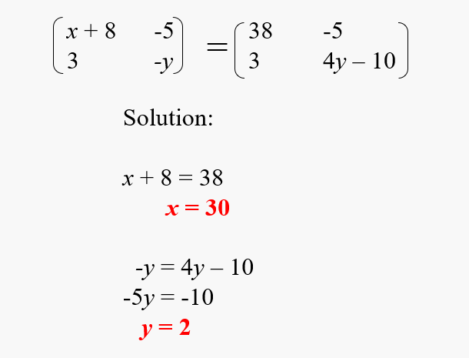
FINDING UNKNOWN MATRIX ELEMENTS
Solve the equation for $x$ and $y$

Slide 21
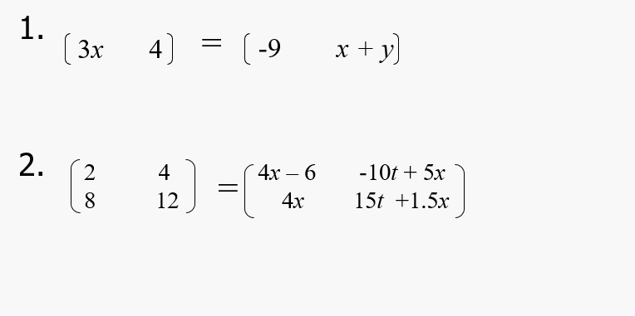


EXERCISE
Solve each unknown variable in each equation

Slide 22
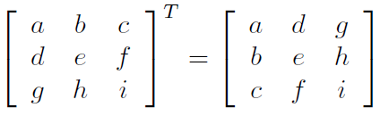
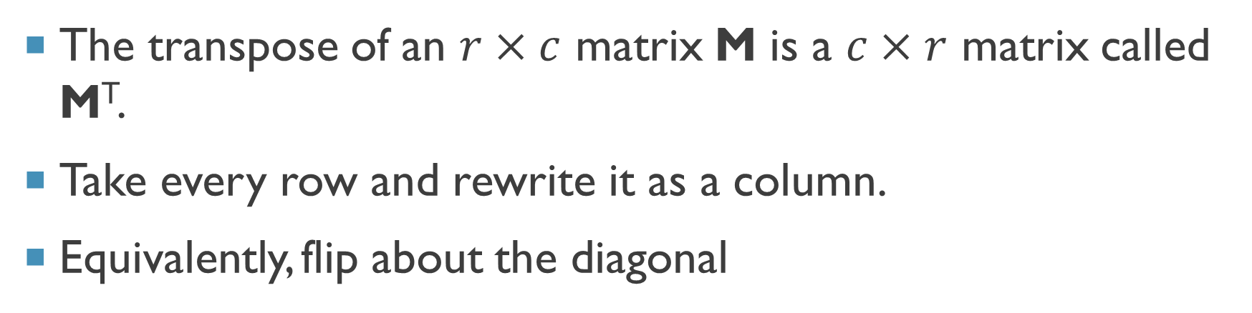
Transpose of a Matrix
The transpose of an $r×c$ matrix M is a $c×r$ matrix called M^{T}.
Take every row and rewrite it as a column.
Equivalently, flip about the diagonal

Slide 23
Facts About Transpose
Transpose is its own inverse: (M^{T})^{T} = M for all matrices M.
D^{T} = D for all diagonal matrices D (including the identity matrix I).

Slide 24
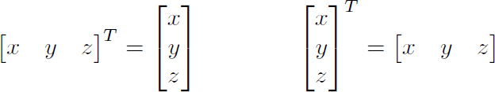
Transpose of a Vector
If v is a row vector, v^{T} is a column vector and vice-versa

Slide 25
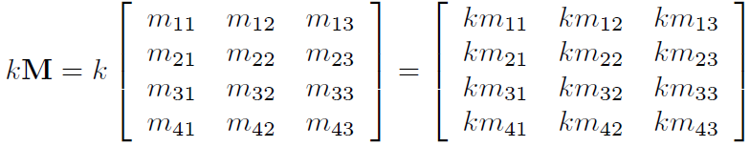
Multiplying By a Scalar
Can multiply a matrix by a scalar.
Result is a matrix of the same dimension.
To multiply a matrix by a scalar, multiply each component by the scalar.

Slide 26
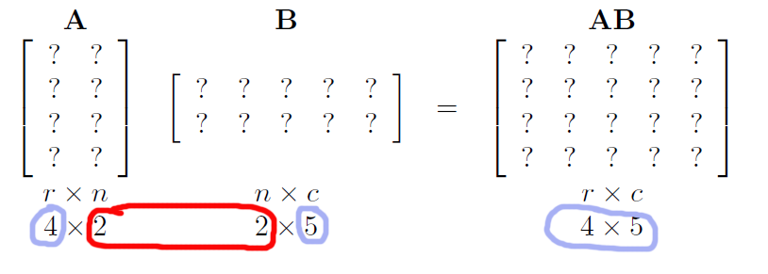
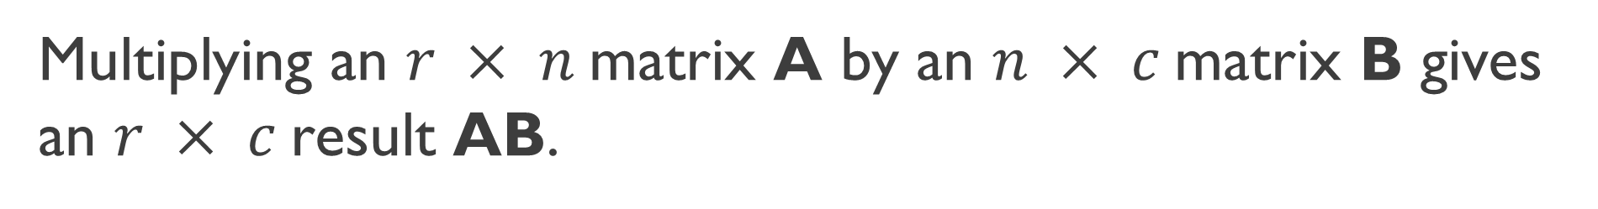
Matrix Multiplication
Multiplying an $r × n$matrix A by an $n × c$matrix B gives an $r × c$result AB.

Slide 27
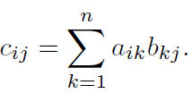
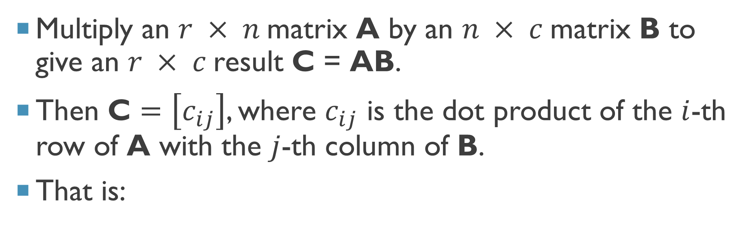
Multiplication: Result
Multiply an $r × n$matrix A by an $n × c$matrix B to give an $r × c$result C = AB.
Then C $=\left[c_{ij}\right]$, where $c_{ij}$ is the dot product of the $i$-th row of A with the $j$-th column of B.
That is:

Slide 28
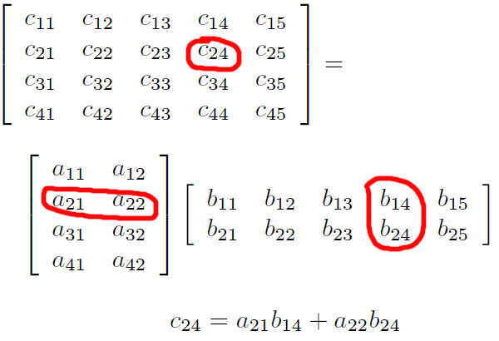
Example

Slide 29
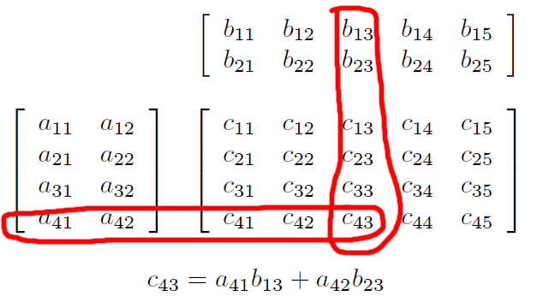
Another Way of Looking at It

Slide 30
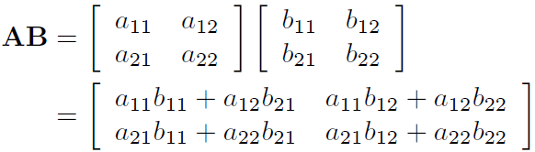
2 x 2 Case

Slide 31
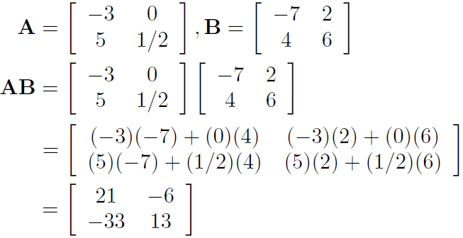
2 x 2 Example

Slide 32
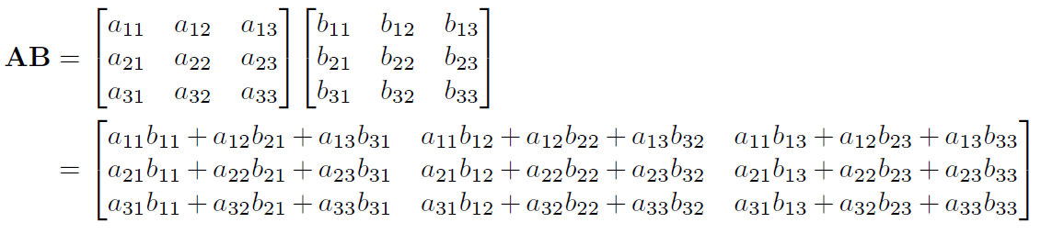
3 x 3 Case

Slide 33
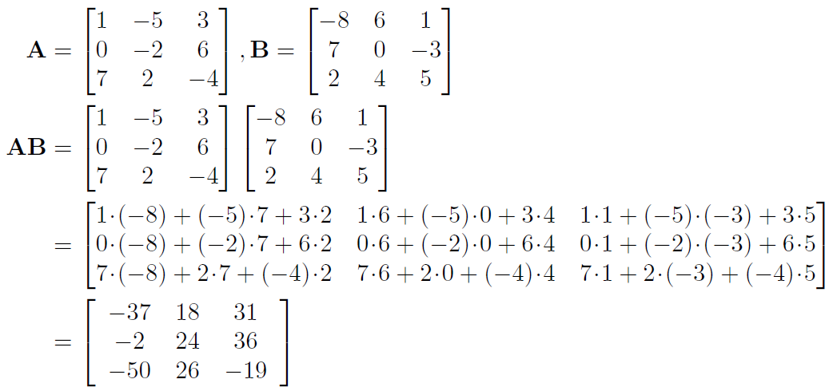
3 x 3 Example

Slide 34
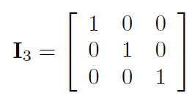
Identity Matrix
Recall that the identity matrix I (or I_{n}) is a diagonal matrix whose diagonal entries are all 1.
Now that we’ve seen the definition of matrix multiplication, we can say that IM = MI = M for all matrices M (dimensions appropriate)

Slide 35
Matrix Multiplication Facts
Not commutative: in general AB ≠ BA.
Associative:
(AB)C = A(BC)
Associates with scalar multiplication:
k(AB) = (kA)B =A(kB)
(AB)^{T} = B^{T}A^{T}
(M₁M₂M₃…M_{n})^{T} = M_{n}^{T} …M₃^{T}M₂^{T}M₁^{T}

Slide 36
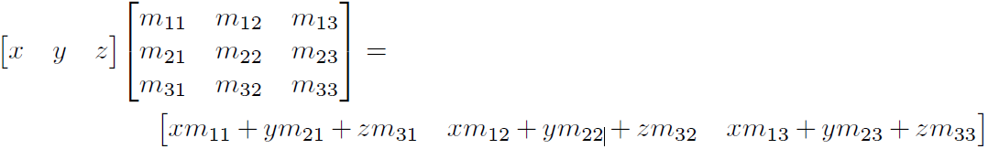
Row Vector Times Matrix Multiplication
Can multiply a row vector times a matrix

Slide 37
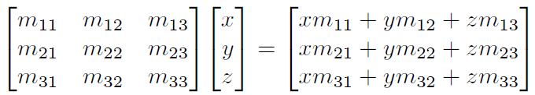
Matrix Times Column Vector Multiplication
Can multiply a matrix times a column vector.

Slide 38
Row vs. Column Vectors
Row vs. column vector matters now. Here’s why: Let v be a row vector, M a matrix.
vM is legal, Mv is undefined
Mv^{T} is legal, v^{T}M is undefined

Slide 39
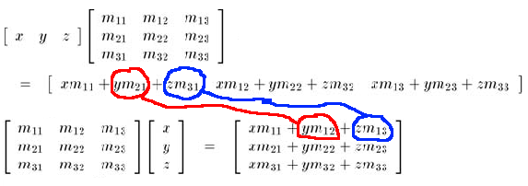
Common Mistake
Mv^{T} ≠ (vM)^{T}, but Mv^{T} = (vM^{T})^{T} – compare the following two results:

Slide 40
Vector-Matrix Multiplication Facts 1
Associates with vector multiplication.
Let v be a row vector:
v(AB) = (vA)B
Let v be a column vector:
(AB)v = A(Bv)

Slide 41
Vector-Matrix Multiplication Facts 2
Vector-matrix multiplication distributes over vector addition:
(v + w)M = vM + wM
That was for row vectors v, w. Similarly for column vectors.

